Slide 1
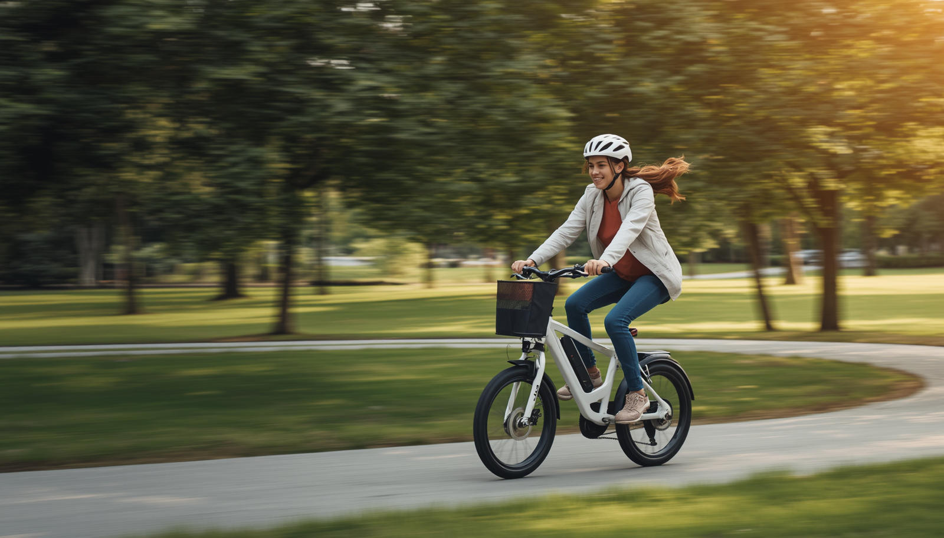
ELECTRIC BICYCLE SAFETY EDUCATION FOR PARENTS

Slide 2
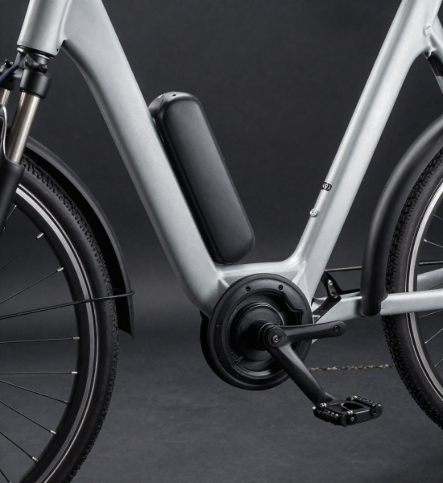
What Is an Electric Bicycle?
Has an integrated electric motor that provides pedal assistance or full throttle power.
  Needs to have functional pedals
  Maximum 750 watt motor
• Class 1: Pedal-assist only, up to 20 mph
• Class 2: Throttle-assisted, up to 20 mph
• Class 3: Pedal-assist only, up to 28 mph

Slide 3

Why E-Bike Safety Matters
E-bike crashes and injuries have increased 18 fold across U.S.
Southern CA is a hot spot with 300% increase over one year
Notes:
Electric bicycle use is increasing across the nation with over 1.1 million bikes sold in the US and a projected annual growth rate of 10%
Especially in Orange County we are seeing huge increases in crashes and injuries with a 300% increase in one year
This impacts youth in particular who are new to these motoroized vehicles

Slide 4
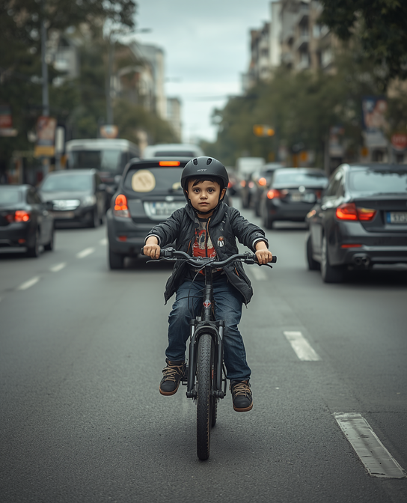
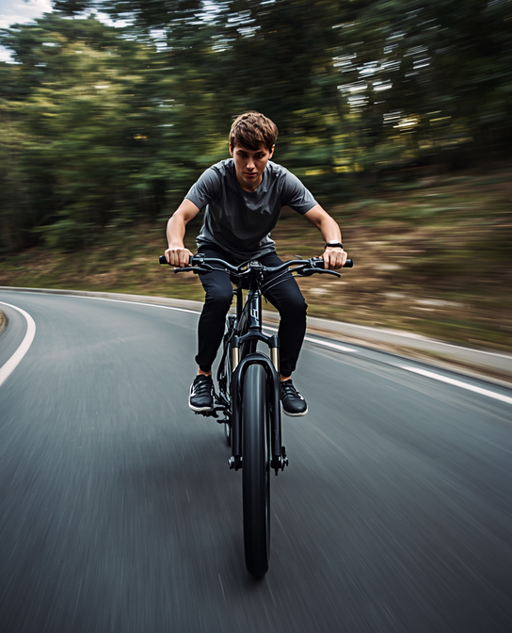
Common Risks of E-bikes
Higher speeds than conventional bikes can lead to more severe falls and longer stopping distances
Motor assistance reduces reaction time awareness
Inexperience with e-bike controls and braking systems increases the risk of losing control
Distraction risks such as phone use or headphones while riding significantly impair awareness of traffic, pedestrians, and road hazards.
URBAN TRAFFIC HAZARDS
HIGH-SPEED RIDING RISKS
Notes:
E-bikes have benefits with increased mobility, reducing traffic congestion, and reducing carbon footprint
Conventional bicycles carry risks of injury especially when sharing a space with motorvehicles
However electric bicycles carry additional risks since they are heavier, faster, longer stopping distance and more difficult to maneuver.
Especially for children and youth, this exposes them to higher risk of injuries. So that e-bike injuries are more similar to motocycle injuries
Youth inexperience with motorized vehicles increases risk of loss of control
Distractions such as a phone or headphone use also decrease awareness of surroundings including other pedestrians and cars

Slide 5
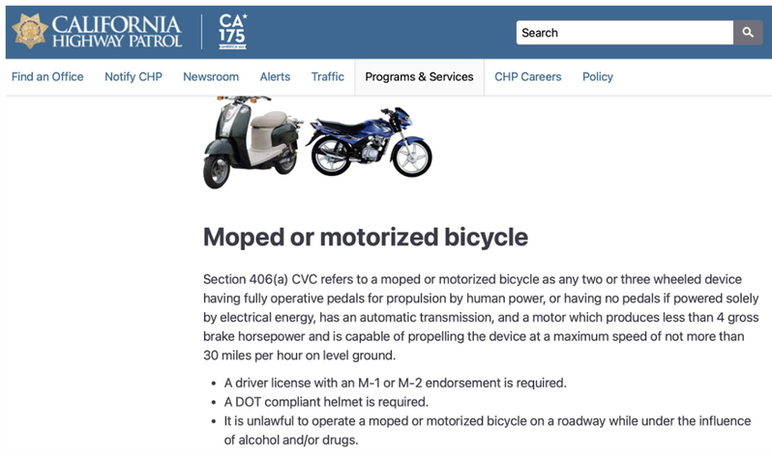
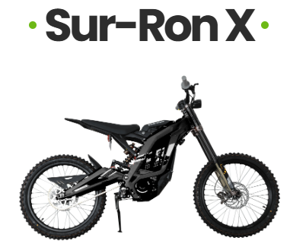
Illegal Modifications, Mopeds & Motorcycles
Know the difference and the law:
• Removing speed limiters or adding higher-power motors is illegal in most areas and voids warranties
• Modified e-bikes may be reclassified as mopeds or motorcycles, requiring registration, insurance, and a license
• Electric mopeds: typically 28-30 mph, require registration and helmet laws apply
• Electric motorcycles: exceed 30 mph, require a motorcycle license and full road compliance
Why this matters for parents:
• Children cannot legally operate mopeds or motorcycles
• Illegal modifications increase crash severity and legal liability
• Insurance will not cover accidents on illegally modified vehicles

Slide 6
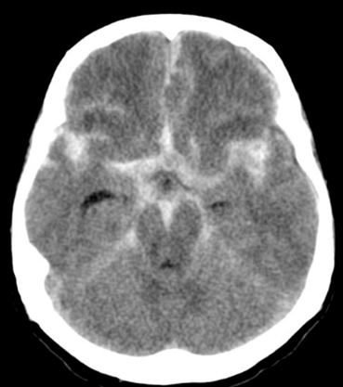
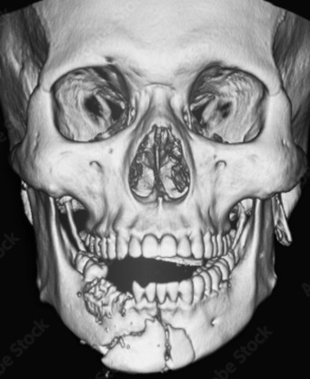
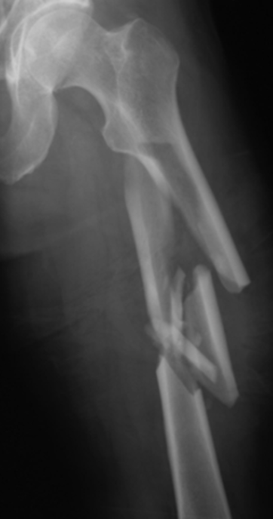
resources
Common Injuries from
E-Bike Crashes
  Higher incidence of head and face injuries with e-bikes compared to conventional bicycles
  Injury patterns more closely resemble motorcycle injuries
  E-bike injuries are more severe, more often require hospitalization , and operations
  Head & Brain Injuries — Concussions and traumatic brain injuries, especially without a helmet
  Fractures — Broken wrists, arms, collarbones, and legs from high-speed falls
  Facial & Dental Injuries — Jaw fractures, broken teeth, and lacerations
  Internal Injuries — Organ damage from high-impact collisions with vehicles

Slide 7
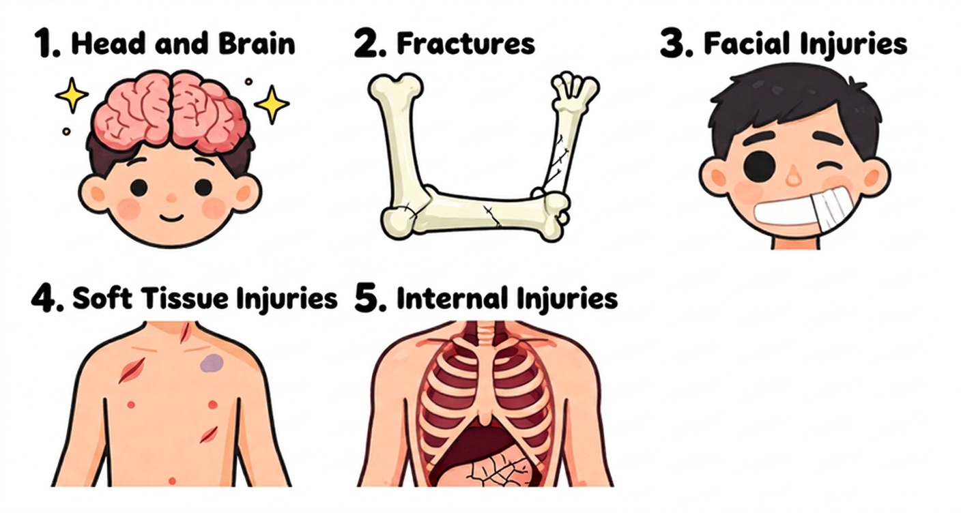

Slide 8
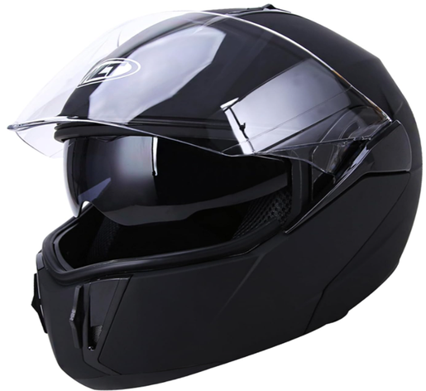
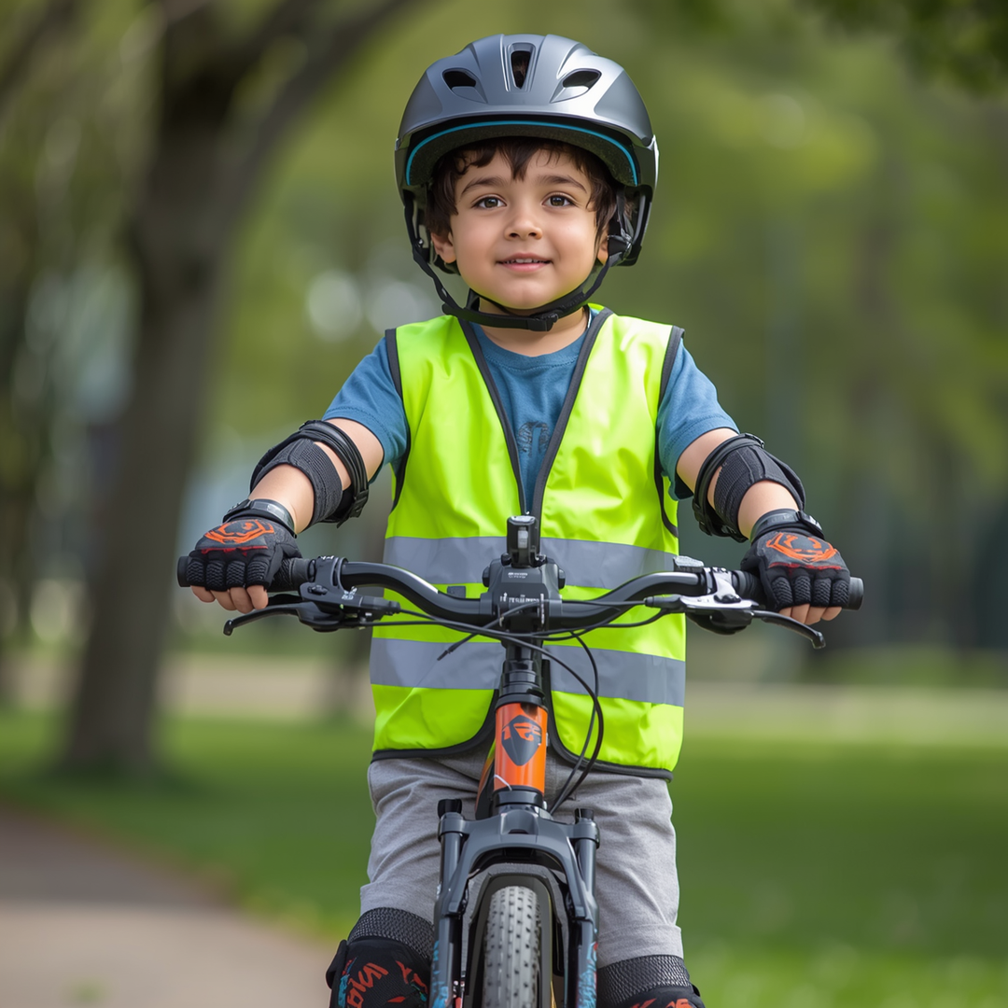
Essential Safety Gear
Head Protection
Always wear a properly fitting helmet certified for e-bike use
-D.O.T Approved
-Full face
Visibility & Awareness
Front and rear lights are essential for low-light riding, while a bell or horn alerts others nearby.
Notes:
Helmets are required for all individuals in CA under 18 years old
Helmet use for adults is also recommended as it protects us from minor concussions to severe traumatic brain injury which are frequently seen with e-bike injuries, similar to moped and motorcycle crashes
Consumer Product Safety Commission recommends a Department of Transportation Helmet for bicycles that go 20 mph or faster which includes Class 1,2, and 3 e-bikes
Full face protection helps reduce severe facial fractures which are increasingly seen in e-bike crashes

Slide 9
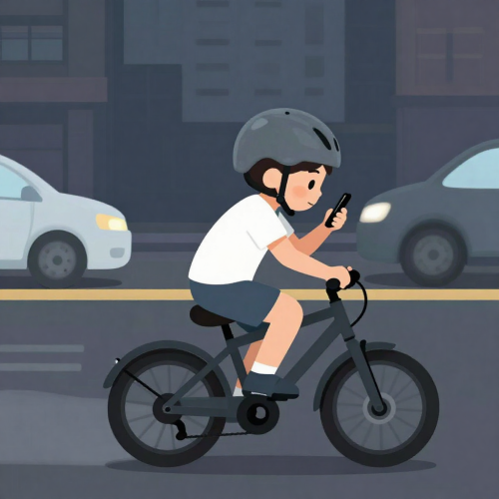
High Risk Scenarios
Who is most at risk?
• Youth under 12 years of age
• Inexperienced or untrained riders
• Lack of knowledge of rules of the road
• No helmet
• Distracted riding (phone, headphones)
• Passenger on a single-rider bike
• Throttle-controlled e-bikes that accelerate quickly
• Modified e-bikes with removed speed limiters

Slide 10
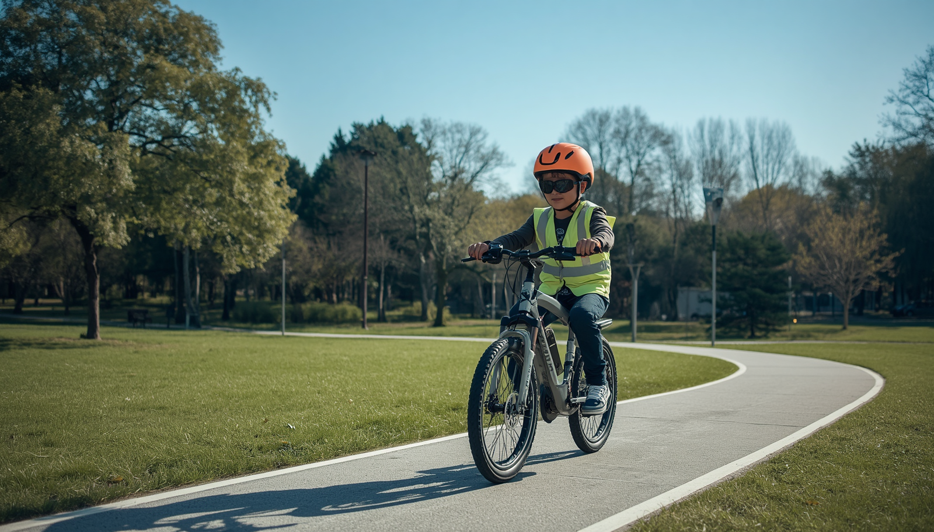
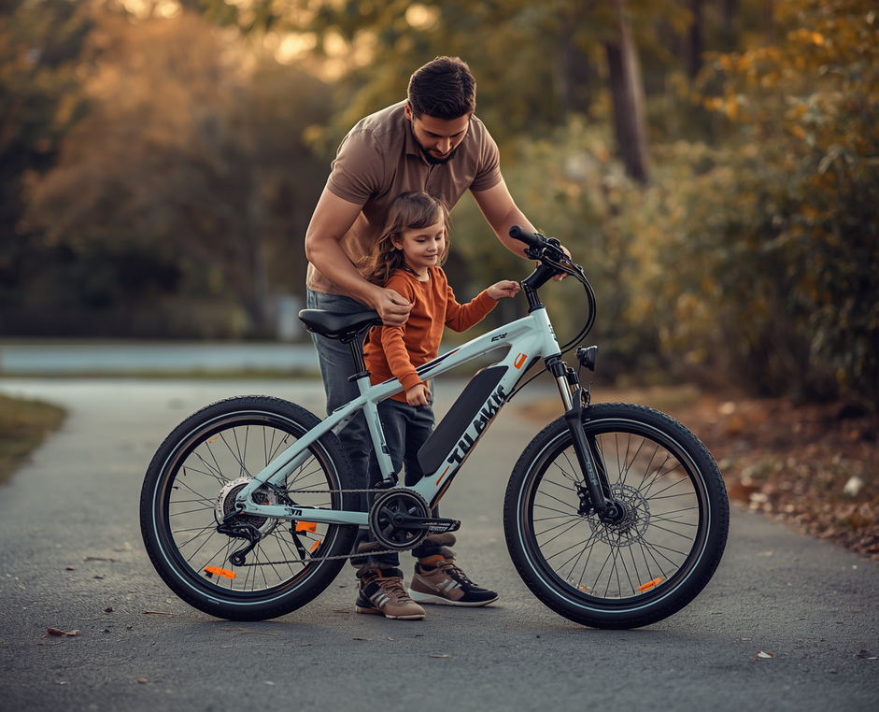
Riding Best Practices
Do's ✓
Always wear a helmet and full safety gear before every ride. Follow all traffic rules, signals, and road markings. Practice riding in safe, low-traffic areas before venturing onto busy roads. Inspect the e-bike's brakes, tires, and battery before each ride.
Don'ts ✗
Never ride at unsafe speeds or in a reckless manner. Do not use a phone or wear headphones while riding. Never carry extra passengers on an e-bike not designed for it.

Slide 11
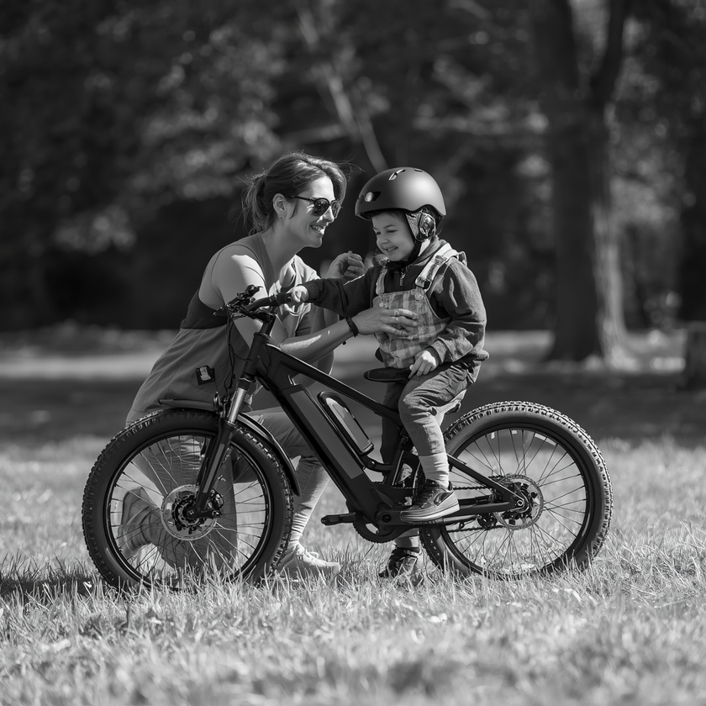
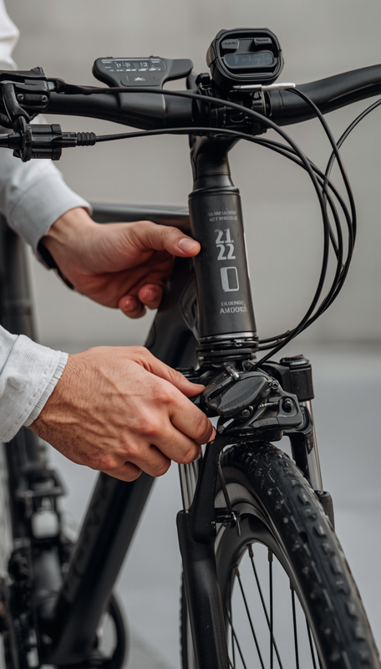
  Teach and model safe riding habits regularly
  Set clear rules about where and when to ride
  Ensure regular maintenance and safety checks
  Encourage participation in a local safety course
  Monitor and supervise young or new e-bike riders
How Parents
Can Help

Slide 12

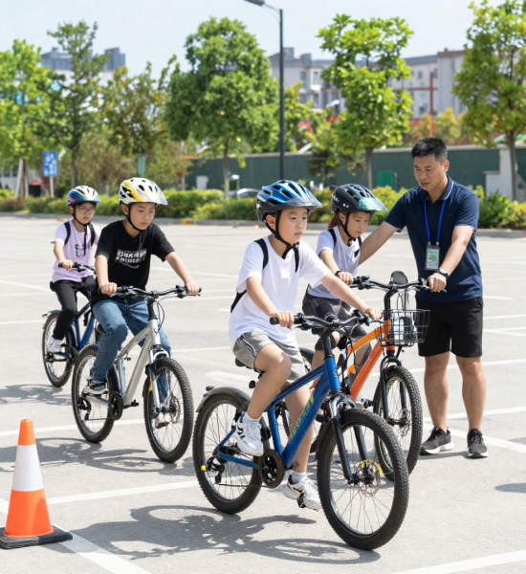

Electric Bicycle Courses
Look for local e-bike safety courses that teach:
• Proper braking and speed control techniques
• Traffic rules and road awareness
• Emergency maneuvers and obstacle avoidance
• Basic e-bike maintenance and inspection
• Group riding etiquette and hand signals
Many bike shops, community centers, and local police departments offer free or low-cost classes for youth and families.

Slide 13
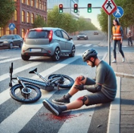
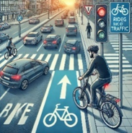
Parent Considerations
Key questions every parent should ask:
1. Should my child be using an e-bike?
2. Age-appropriate use (developmental readiness)
3. Knowledge of vehicle and rules of the road
4. Skills
5. Experience

